Slide 1

Simulation of Dynamical Systems
MTH 564 – Mathematical Modeling

Slide 2
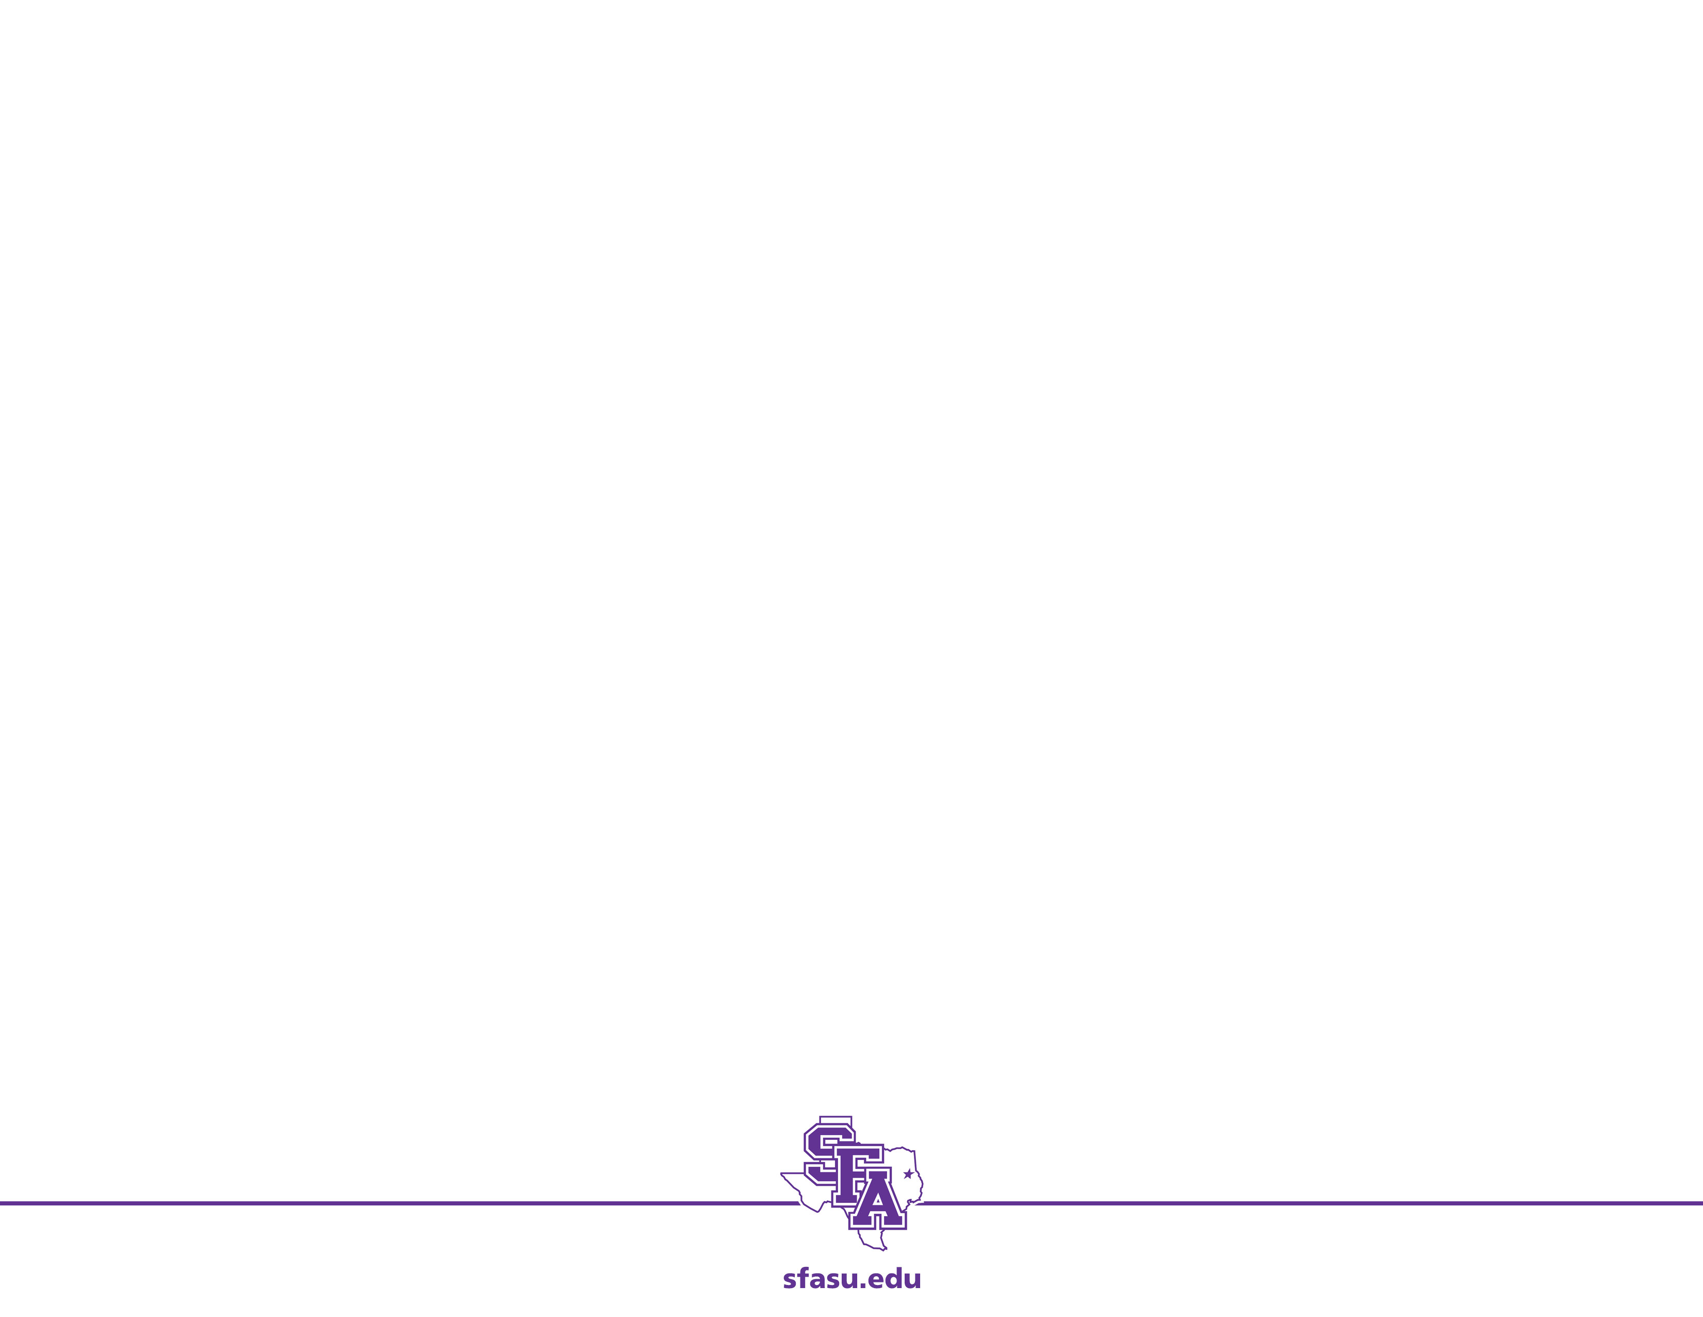
Simulation of Discrete Time Dynamical Systems
Simulation Overview
Simulation is one of the most popular means of studying dynamical systems.
Solving differential equations is hard and we cannot solve that many of them.
Simulations provide a qualitative answer and typically a high degree of accuracy.
Simulations are flexible
Allow for the introduction of time delays
Can be combined with stochastic elements
The primary drawback is sensitivity analysis is difficult
Requires that we rerun the entire simulation with different values of the parameter.
This can be very expensive and time consuming.

Slide 3
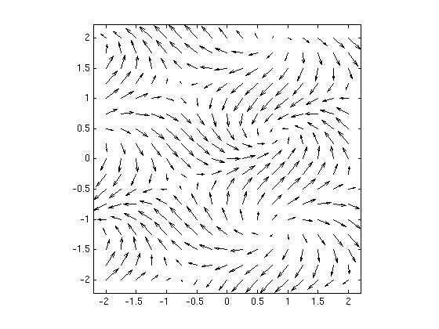
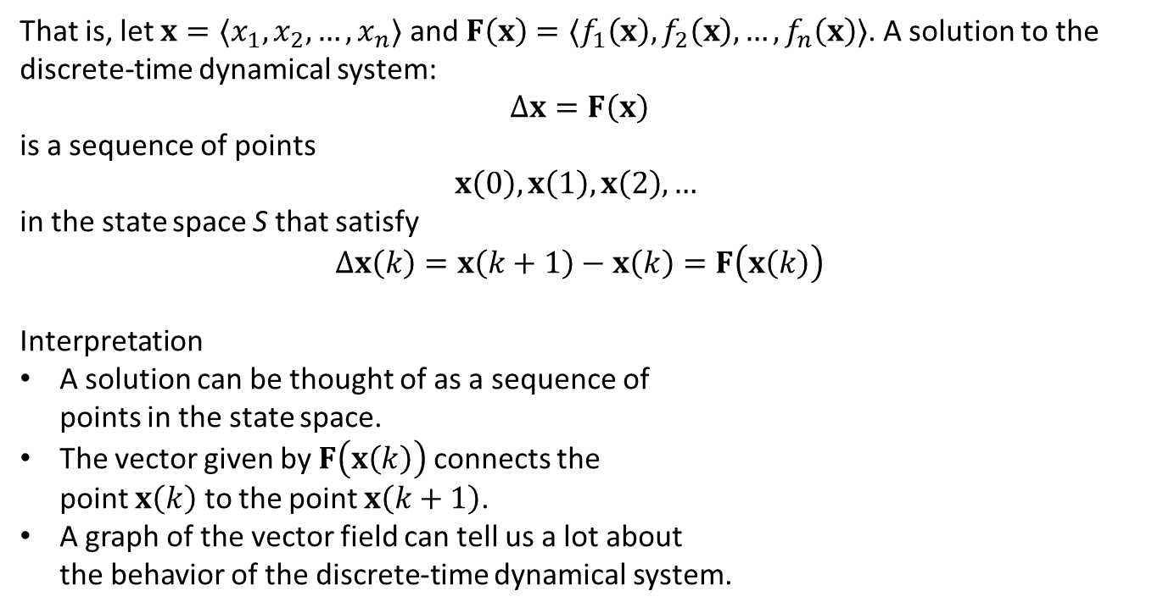



Discrete Dynamic Systems: Terminology
That is, let ${x=〈x}_{1},x_{2},…,x_{n}〉$ and $F\left(x\right)=〈f_{1}\left(x\right), f_{2}\left(x\right),…,f_{n}\left(x\right)〉$. A solution to the discrete-time dynamical system:
$$Δx=F\left(x\right)$$
is a sequence of points
$$x\left(0\right), x\left(1\right),x\left(2\right),…$$
in the state space S that satisfy
$$Δx\left(k\right)=x\left(k+1\right)−x\left(k\right)=F\left(x\left(k\right)\right)$$
Interpretation
A solution can be thought of as a sequence of points in the state space.
The vector given by $F\left(x\left(k\right)\right)$ connects the point $x\left(k\right)$ to the point $x\left(k+1\right)$.
A graph of the vector field can tell us a lot about the behavior of the discrete-time dynamical system.
$$x\left(k\right)$$
$$F\left(x\left(k\right)\right)$$
$$x\left(k+1\right)$$

Slide 4
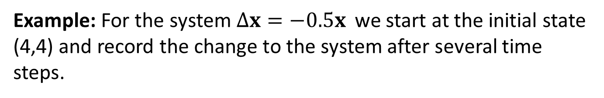
Example: Sequences
Example: For the system$Δx=−0.5x$ we start at the initial state (4,4) and record the change to the system after several time steps.
Time Step | State
0 | (4,4)
1 | (2, 2)
2 | (1, 1)
3 | (0.5, 0.5)
4 | (0.25, 0.25)
5 | (0.125, 0.125)
Interpretation: At every time step we move half the distance towards the origin.
The origin is a stable equilibrium for this system.

Slide 5
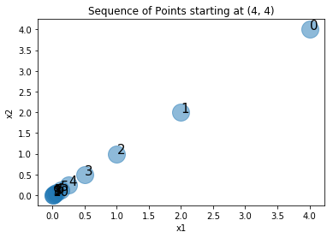
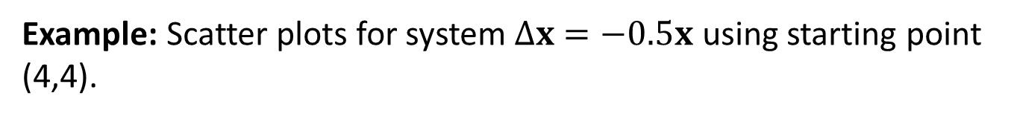
Example: Scatter Plot
Example: Scatter plots for system$Δx=−0.5x$ using starting point (4,4).
Behavior: Gradually move towards stable equilibrium at the origin (0,0).

Slide 6
Example: Battle
Two forces which we call red (R) and blue (B) are engaged in a battle. In this conventional battle, attrition is a result of direct fire (infantry) and area fire (artillery). The attrition rate due to direct fire is assumed to be directly proportional to the number of infantry. The attrition rate due to enemy artillery is due to both the amount of enemy artillery and the density of opposing troops.
Red has amassed 5 division to attack a blue force of 2 divisions. Blue has the advantage of defense and superior weapons. How much more effective does blue have to be in order to prevail in the battle?

Slide 7
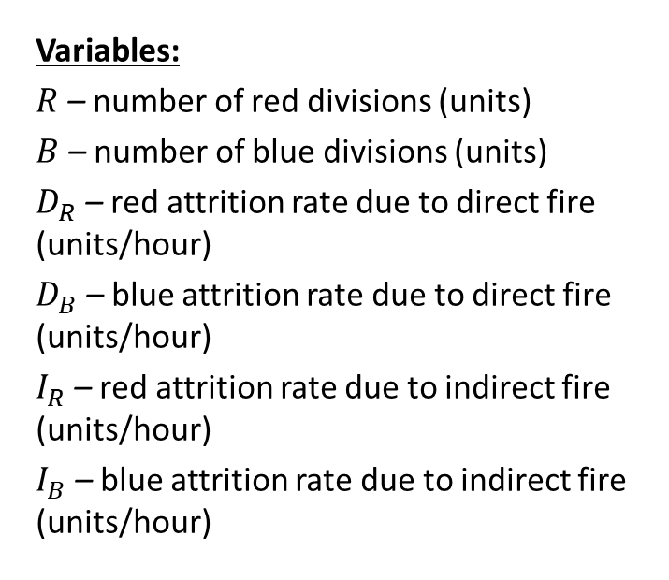
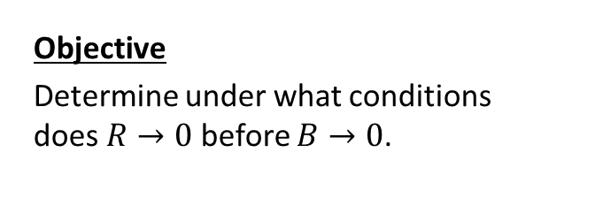
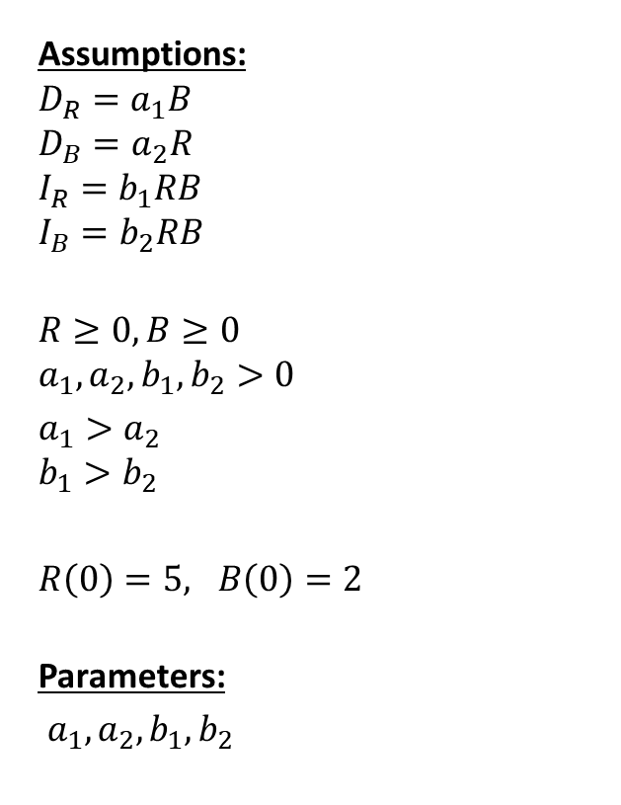
Step 1: Ask the question.
Variables:
$R$ – number of red divisions (units)
$B$ – number of blue divisions (units)
$D_{R}$ – red attrition rate due to direct fire (units/hour)
$D_{B}$ – blue attrition rate due to direct fire (units/hour)
$I_{R}$ – red attrition rate due to indirect fire (units/hour)
$I_{B}$ – blue attrition rate due to indirect fire (units/hour)
Assumptions:
$$D_{R}=a_{1}B$$
$$D_{B}=a_{2}R$$
$$I_{R}=b_{1}RB$$
$$I_{B}=b_{2}RB$$
$$R≥0, B≥0 \\ a_{1}, a_{2}, b_{1},b_{2}>0$$
$a_{1}>a_{2}$ $b_{1}>b_{2}$
$R\left(0\right)=5, B\left(0\right)=2$
Parameters:
$a_{1}, a_{2}, b_{1},b_{2}$
Objective
Determine under what conditions does $R→0$ before $B→0$.

Slide 8
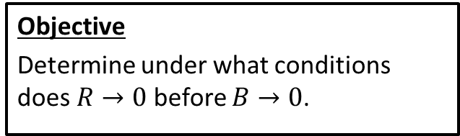
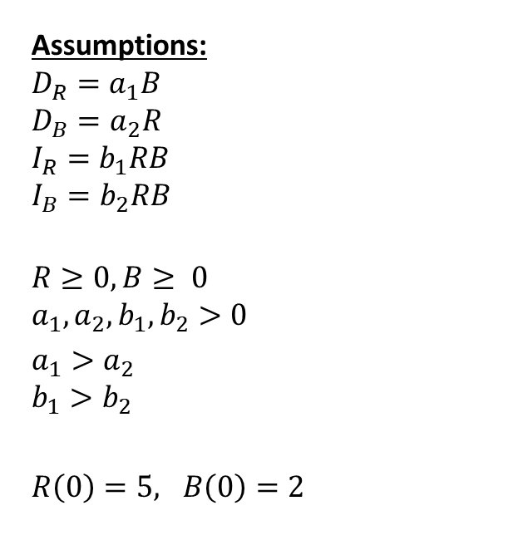
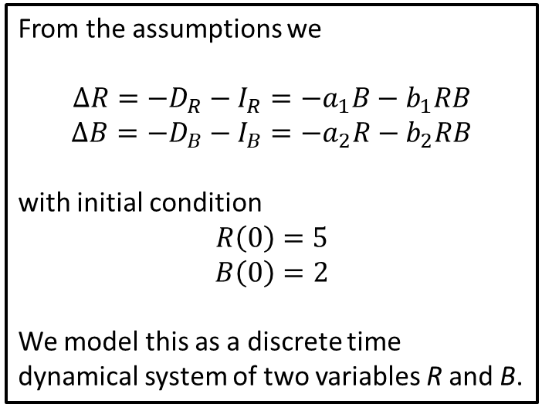
Step 2: Select the modeling approach
Assumptions:
$$D_{R}=a_{1}B$$
$$D_{B}=a_{2}R$$
$$I_{R}=b_{1}RB$$
$$I_{B}=b_{2}RB$$
$$R≥0, B≥ 0 \\ a_{1}, a_{2}, b_{1},b_{2}>0$$
$a_{1}>a_{2}$ $b_{1}>b_{2}$
$R\left(0\right)=5, B\left(0\right)=2$
From the assumptions we
$$ΔR=−D_{R}−I_{R}=−a_{1}B−b_{1}RB$$
$$ΔB=−D_{B}−I_{B}=−a_{2}R−b_{2}RB$$
with initial condition
$$R\left(0\right)=5$$
$$B\left(0\right)=2$$
We model this as a discrete time dynamical system of two variables R and B.
Objective
Determine under what conditions does $R→0$ before $B→0$.

Slide 9
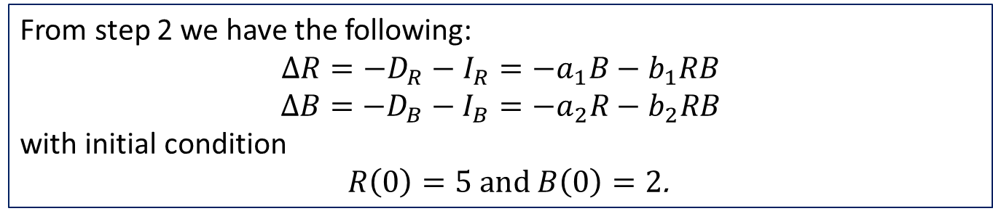
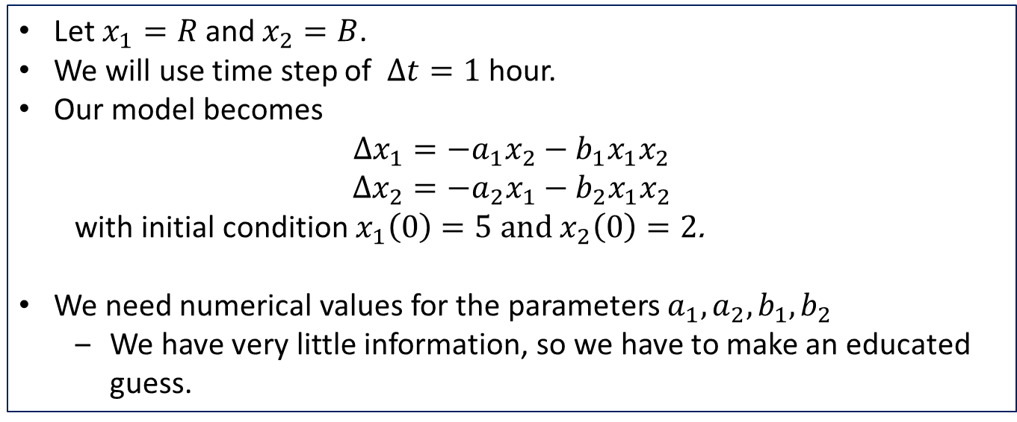
Step 3: Formulate the model
From step 2 we have the following:
$$ΔR=−D_{R}−I_{R}=−a_{1}B−b_{1}RB$$
$$ΔB=−D_{B}−I_{B}=−a_{2}R−b_{2}RB$$
with initial condition
$R\left(0\right)=5$ and $B\left(0\right)=2$.
Let $x_{1}=R$ and $x_{2}=B$.
We will use time step of $Δt=1$ hour.
Our model becomes $Δx_{1}=−a_{1}x_{2}−b_{1}x_{1}x_{2}$
$$Δx_{2}=−a_{2}x_{1}−b_{2}x_{1}x_{2}$$
with initial condition $x_{1}\left(0\right)=5$ and $x_{2}\left(0\right)=2$.
We need numerical values for the parameters $a_{1}, a_{2}, b_{1},b_{2}$
We have very little information, so we have to make an educated guess.

Slide 10

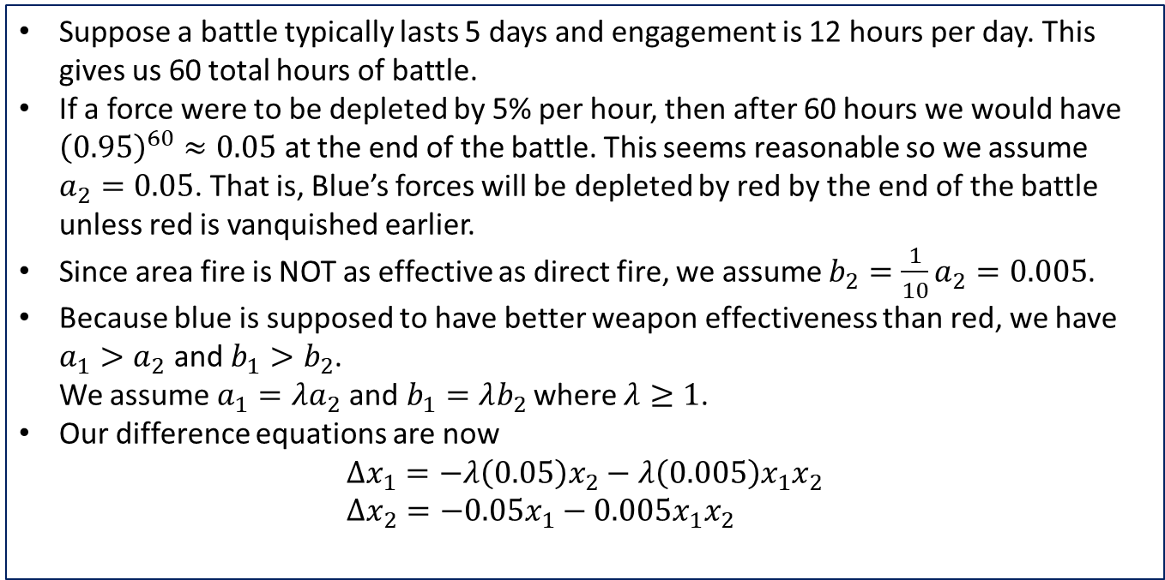
Step 3: Formulate the model
We have the following:
$$Δx_{1}=−a_{1}x_{2}−b_{1}x_{1}x_{2}$$
$$Δx_{2}=−a_{2}x_{1}−b_{2}x_{1}x_{2}$$
with initial condition $x_{1}\left(0\right)=5$ and $x_{2}\left(0\right)=2$.
Suppose a battle typically lasts 5 days and engagement is 12 hours per day. This gives us 60 total hours of battle.
If a force were to be depleted by 5% per hour, then after 60 hours we would have ${\left(0.95\right)}^{60}≈0.05$ at the end of the battle. This seems reasonable so we assume $a_{2}=0.05$. That is, Blue’s forces will be depleted by red by the end of the battle unless red is vanquished earlier.
Since area fire is NOT as effective as direct fire, we assume $b_{2}=\frac{1}{10}a_{2}=0.005$.
Because blue is supposed to have better weapon effectiveness than red, we have $a_{1}>a_{2}$ and $b_{1}>b_{2}$. We assume $a_{1}=λa_{2}$ and$b_{1}=λb_{2}$ where $λ≥1$.
Our difference equations are now $Δx_{1}=−λ\left(0.05\right)x_{2}−λ\left(0.005\right)x_{1}x_{2}$ $Δx_{2}=−0.05x_{1}−0.005x_{1}x_{2}$

Slide 11
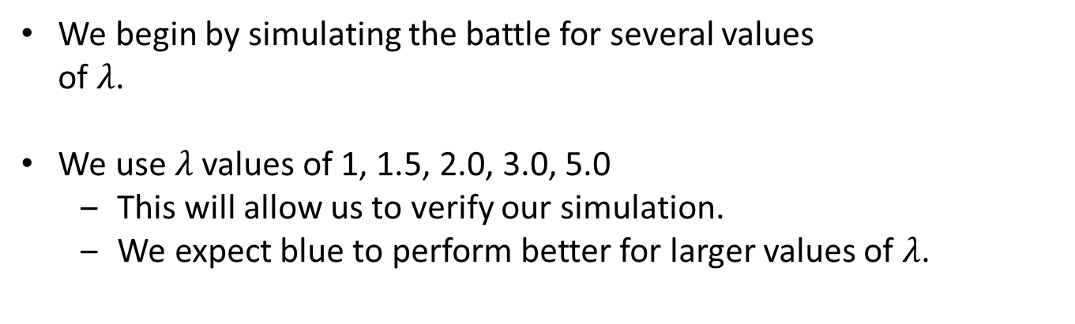
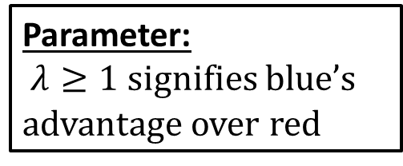
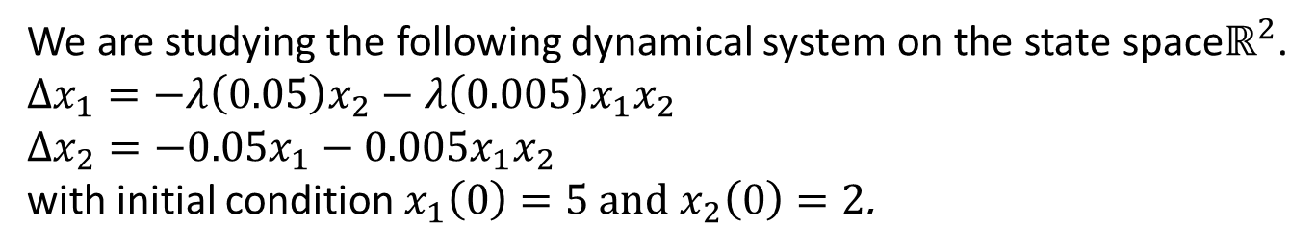
Step 4: Solve the Problem
We are studying the following dynamical system on the state space$ℝ^{2}$. $Δx_{1}=−λ\left(0.05\right)x_{2}−λ\left(0.005\right)x_{1}x_{2}$
$Δx_{2}=−0.05x_{1}−0.005x_{1}x_{2}$
with initial condition $x_{1}\left(0\right)=5$ and $x_{2}\left(0\right)=2$.
Parameter:
$λ≥1$ signifies blue’s advantage over red
We begin by simulating the battle for several values of $λ$.
We use $λ$ values of 1, 1.5, 2.0, 3.0, 5.0
This will allow us to verify our simulation.
We expect blue to perform better for larger values of $λ$.

Slide 12
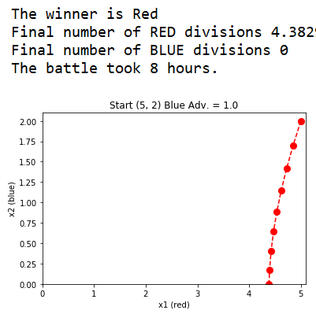
Step 4: Simulation

Slide 13
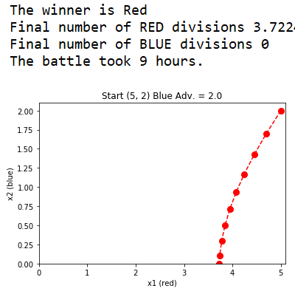
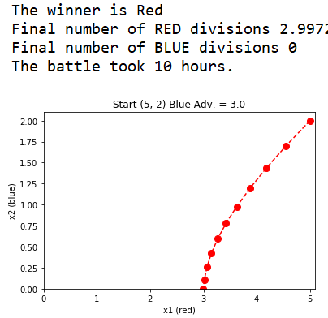
Step 4: Simulation

Slide 14
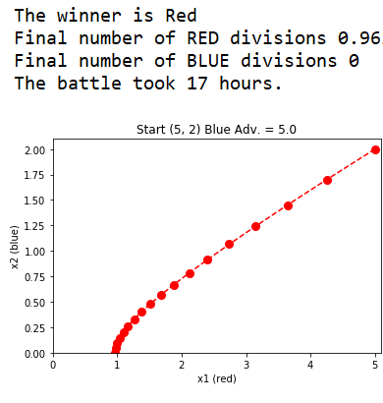
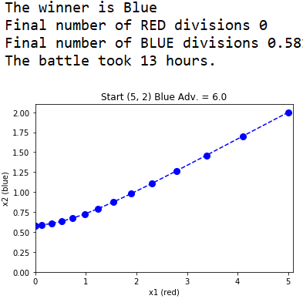
Step 4: Simulation

Slide 15
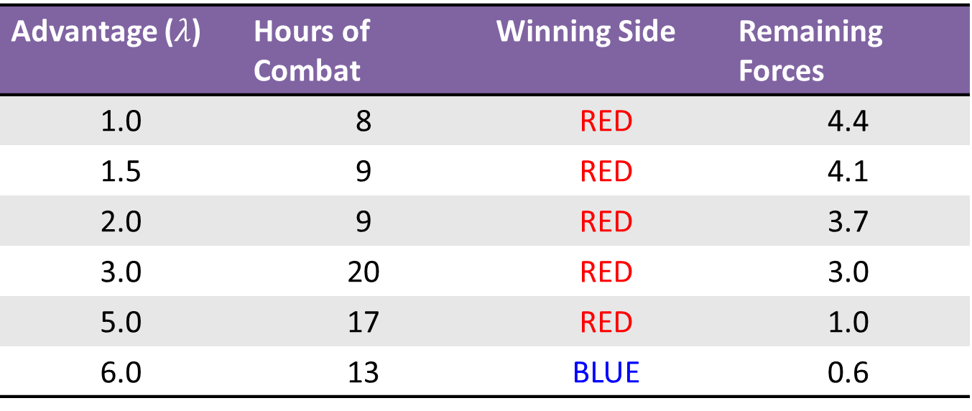
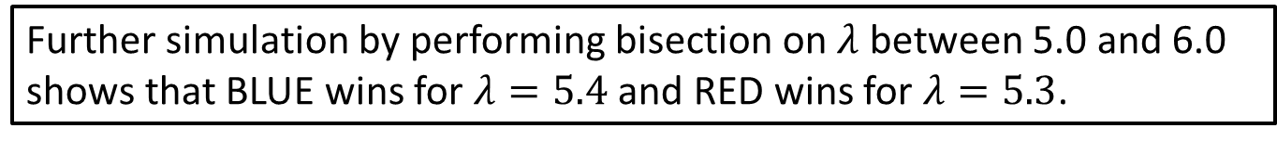
Step 4: Simulation Summary
Advantage ($λ$) | Hours of Combat | Winning Side | Remaining Forces
1.0 | 8 | RED | 4.4
1.5 | 9 | RED | 4.1
2.0 | 9 | RED | 3.7
3.0 | 20 | RED | 3.0
5.0 | 17 | RED | 1.0
6.0 | 13 | BLUE | 0.6
Further simulation by performing bisection on $λ$ between 5.0 and 6.0 shows that BLUE wins for $λ=5.4$ and RED wins for $λ=5.3$.

Slide 16
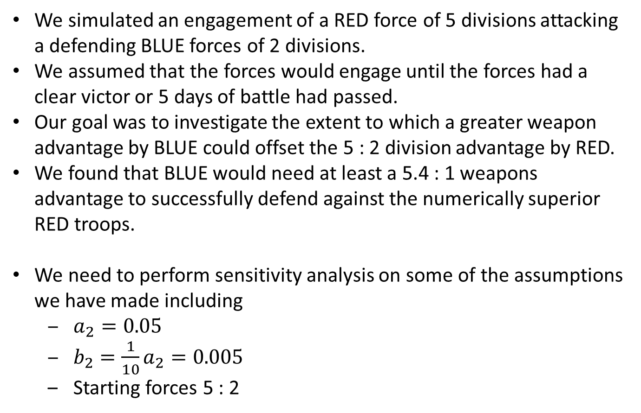
Step 5: Answer the question
We simulated an engagement of a RED force of 5 divisions attacking a defending BLUE forces of 2 divisions.
We assumed that the forces would engage until the forces had a clear victor or 5 days of battle had passed.
Our goal was to investigate the extent to which a greater weapon advantage by BLUE could offset the 5 : 2 division advantage by RED.
We found that BLUE would need at least a 5.4 : 1 weapons advantage to successfully defend against the numerically superior RED troops.
We need to perform sensitivity analysis on some of the assumptions we have made including
$a_{2}=0.05$
$b_{2}=\frac{1}{10}a_{2}=0.005$
Starting forces 5 : 2

Slide 17

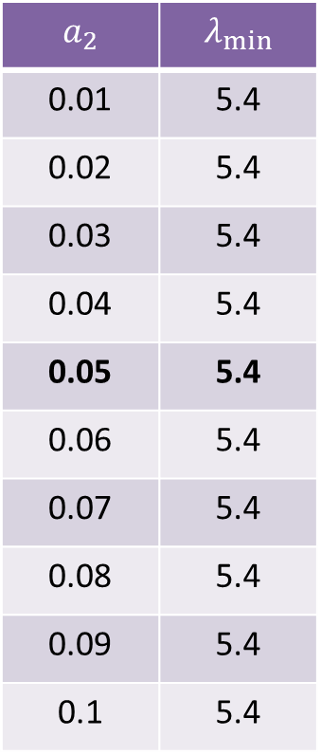
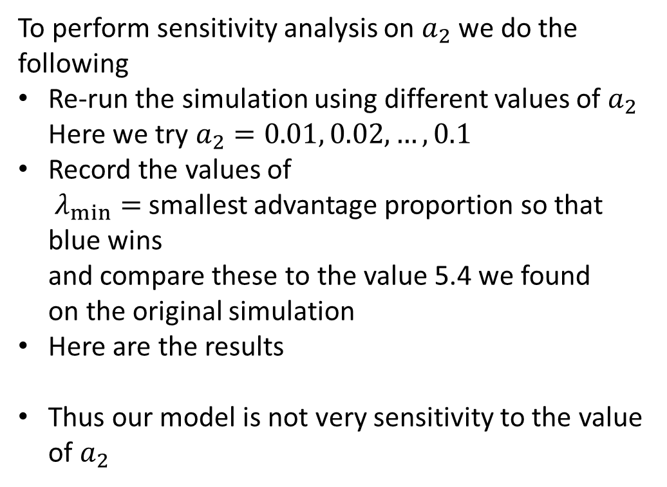
Sensitivity: $a_{2}$
To perform sensitivity analysis on $a_{2}$ we do the following
Re-run the simulation using different values of $a_{2}$ Here we try $a_{2}=0.01, 0.02, …, 0.1$
Record the values of $λ_{min}=$ smallest advantage proportion so that blue wins and compare these to the value 5.4 we found on the original simulation
Here are the results
Thus our model is not very sensitivity to the value of $a_{2}$
$$a_{2}$$ | $$λ_{min}$$
0.01 | 5.4
0.02 | 5.4
0.03 | 5.4
0.04 | 5.4
0.05 | 5.4
0.06 | 5.4
0.07 | 5.4
0.08 | 5.4
0.09 | 5.4
0.1 | 5.4

Slide 18
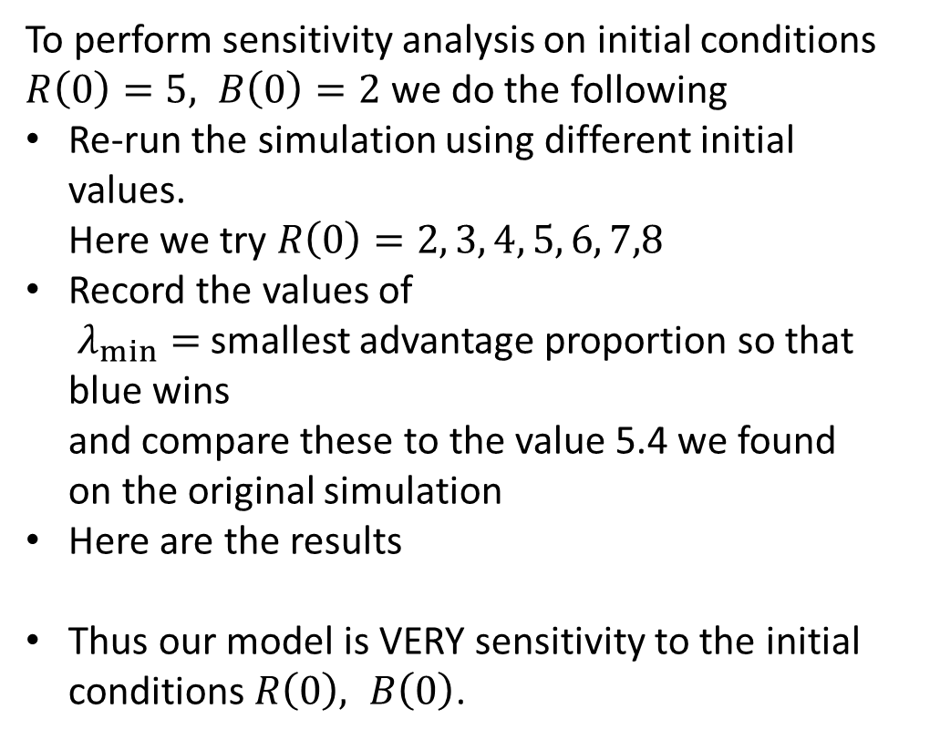
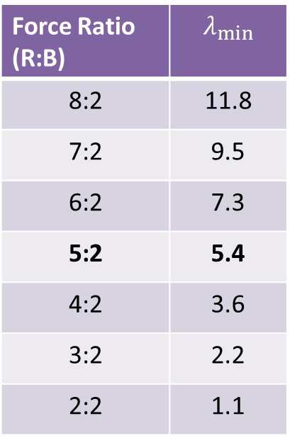
Sensitivity: Starting Divisions
To perform sensitivity analysis on initial conditions $R\left(0\right)=5, B\left(0\right)=2$we do the following
Re-run the simulation using different initial values. Here we try $R\left(0\right)=2, 3, 4, 5, 6, 7,8$
Record the values of $λ_{min}=$ smallest advantage proportion so that blue wins and compare these to the value 5.4 we found on the original simulation
Here are the results
Thus our model is VERY sensitivity to the initial conditions $R\left(0\right), B\left(0\right)$.
Force Ratio (R:B) | $$λ_{min}$$
8:2 | 11.8
7:2 | 9.5
6:2 | 7.3
5:2 | 5.4
4:2 | 3.6
3:2 | 2.2
2:2 | 1.1

